Slide 1
Library Management
System
Presented by: Team Dragonites
Khushil Modi
Sarjak Patel
Nevil Shah
Vishnu Yeruva

Slide 2
Introduction
Library management System is a software that is used to manage and perform all the functions of the library.
It helps the librarian to maintain the record of the students accessing the library and maintains the database of the books.

Slide 3
Scope
Authenticate users at the time of login.
New students can register themselves.
Providing list of books that can be reserved.
Providing interface to add or remove books to the librarian.
Providing access to admin for management of all the types of accounts.
To protect the loss of any single record by recording every transaction in computerized system

Slide 4
Product Functions
The system provides different types of functions based on the type of user:
Student user
List of books that are already reserved by the student
Browse the books or journals which can be reserved .
Admin user
A list of all the user account
Manage the account and change the role of user if required.
Enable/disable a user account

Slide 5
Employee User
Employee User
Process/unprocess the reservations requested by the user.
List of all the students with their details
Add or remove any book , novel or journal.
List of all the books or journals in the library with its edition

Slide 6
User Components
There are 3 User Classes in this software depending on the type of role:
Admin
User
Employee

Slide 7
Technical Stack
Front-End Development: Thymeleaf, HTML, CSS
Back-end Development : Springboot
Database :h2
Java Persistence API (JPA)
Jenkins
Heroku

Slide 8
Check user issue/return
Registered
User
User Database
New Student
Status
Reg No
Register
Book Database
Reg No.
Calculate Fine
Admin
Login
Login
User View the Book
Update
Search
Data Expiry
Add
Available
Book Search Info
Update Book Info
Add Book Info
Request book
Book Return
Updated
Record
Viewed
Record
Added Record
Issuing Book
Book Database
Book/User Database

Slide 9
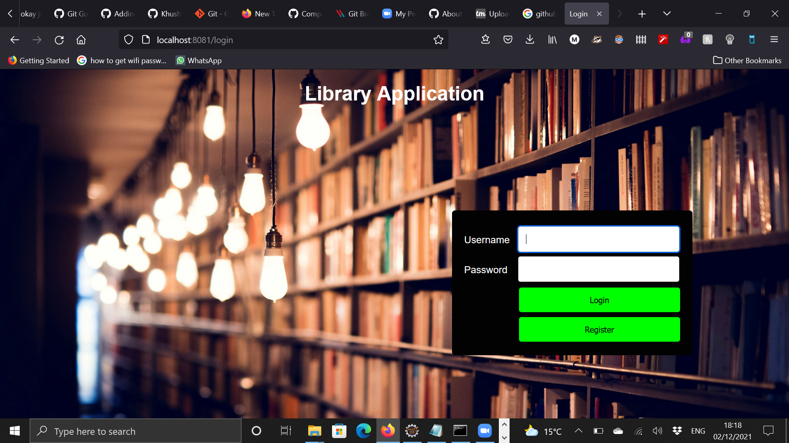
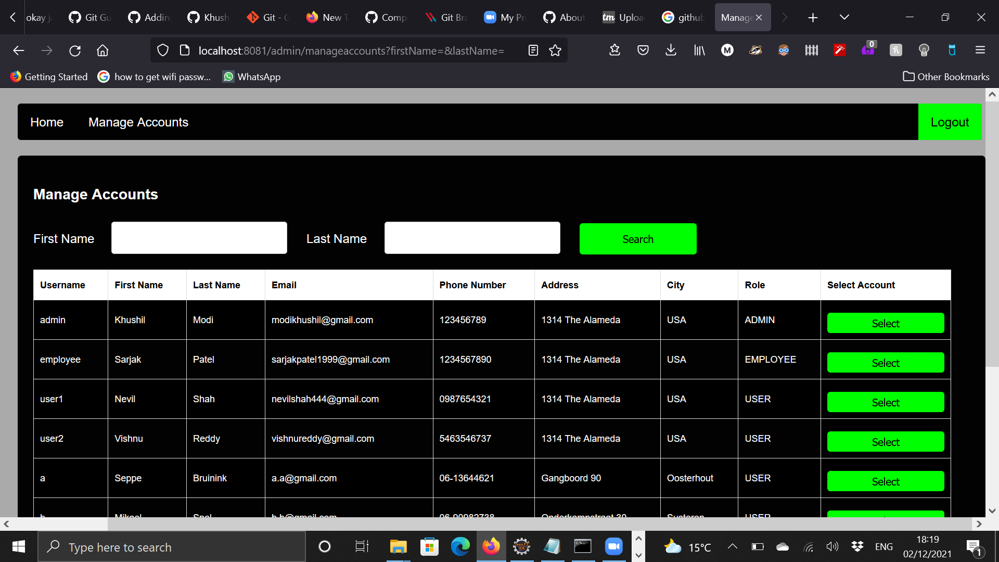

Slide 10
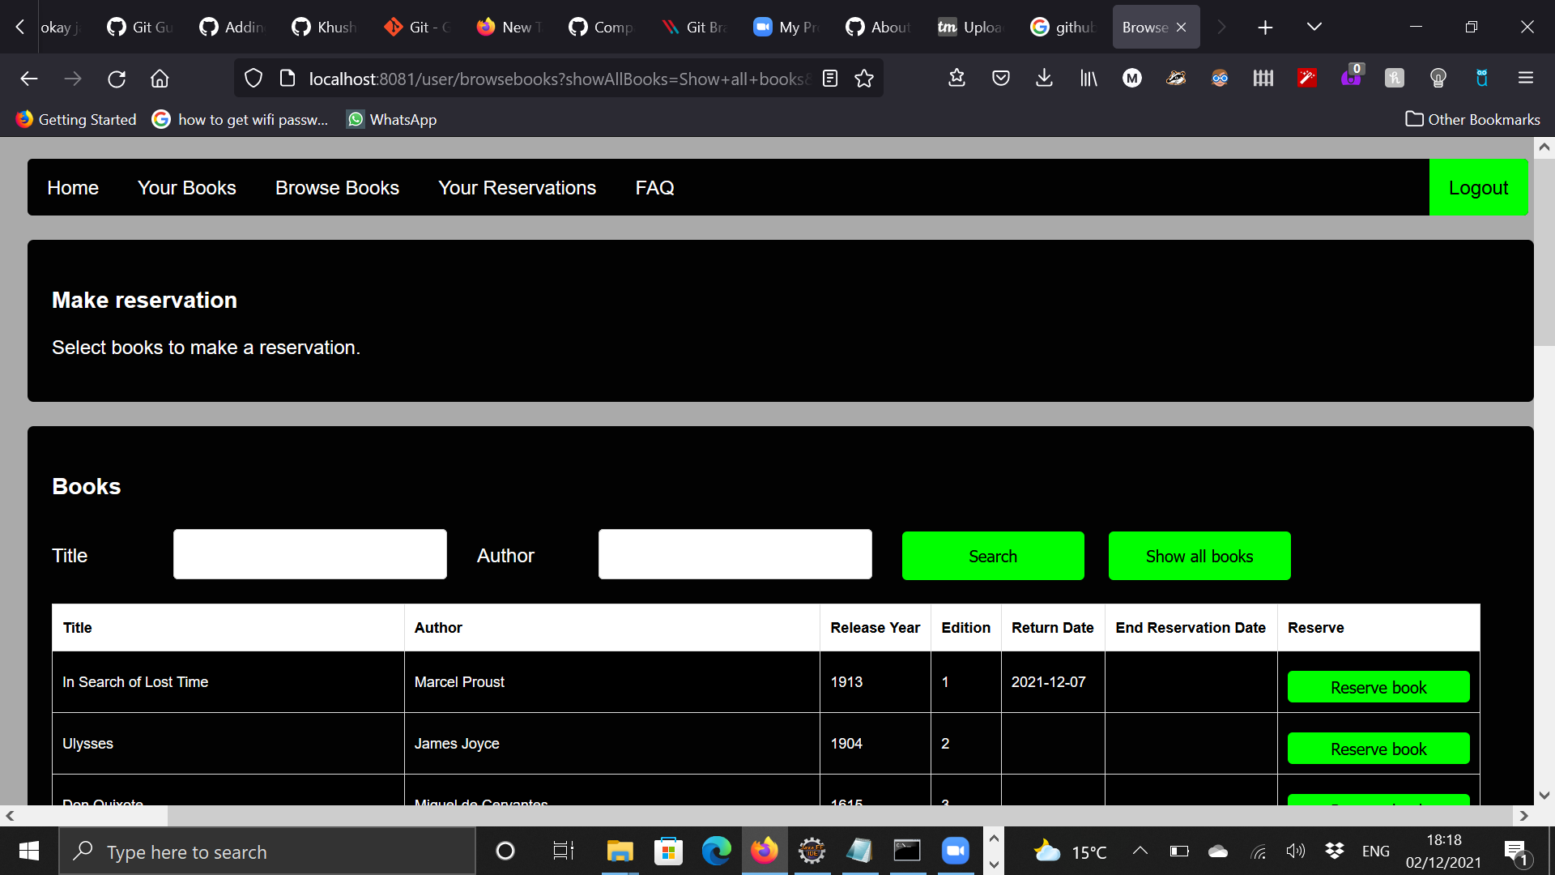

Slide 11
Thank you
Any Questions?

